Slide 1
Please set up your page like this Rule the page and write down a tile and the date.
06.02.2020
Introduction to Landforms and Landscapes

Slide 2
Write down the following…
Learning Intention: Understand the difference between a landform and a landscape.
Activity One: Brainstorm natural features that make up Australia’s Natural Identity. (Minimum of 5 examples of natural features)

Slide 3
Watch the video…
https://www.youtube.com/watch?v=dNOa_XXt8xY
As you watch you can add more examples to your list and note down anything you find interesting

Slide 4
Write down the following definitions…
Landform: The individual surface features of the Earth identified by their shape that make up landscapes, such as: mountains, sand dunes, valleys, beaches, lakes or streams.
Landscape: A landscape is the visible appearance of an area, created by a combination of geological, geomorphological, biological, and cultural layers that have evolved over time, and as perceived, portrayed and valued by people. These are areas on the earth that have particular characteristics. These areas are made up of landforms. They can either be built or natural landscapes.
Natural: Mountain, Coastal, Desert, Tropical, Karst, Riverine
Human: Settlements, buildings, roads, pipelines.

Slide 5
Watch the video…
https://www.youtube.com/watch?v=BsqKTJtK_vw
As you watch you can add more examples to your list and note down anything you find interesting

Slide 6
Write down the following…
Key inquiry question:
What are different types of landscapes and their distinctive landform features?

Slide 7
Instructions
For each photograph of a landscape:
Name the landscape type
How do you know its that type of landscape? (List the landforms you see)
Provide examples of this landscape found in the world.

Slide 8
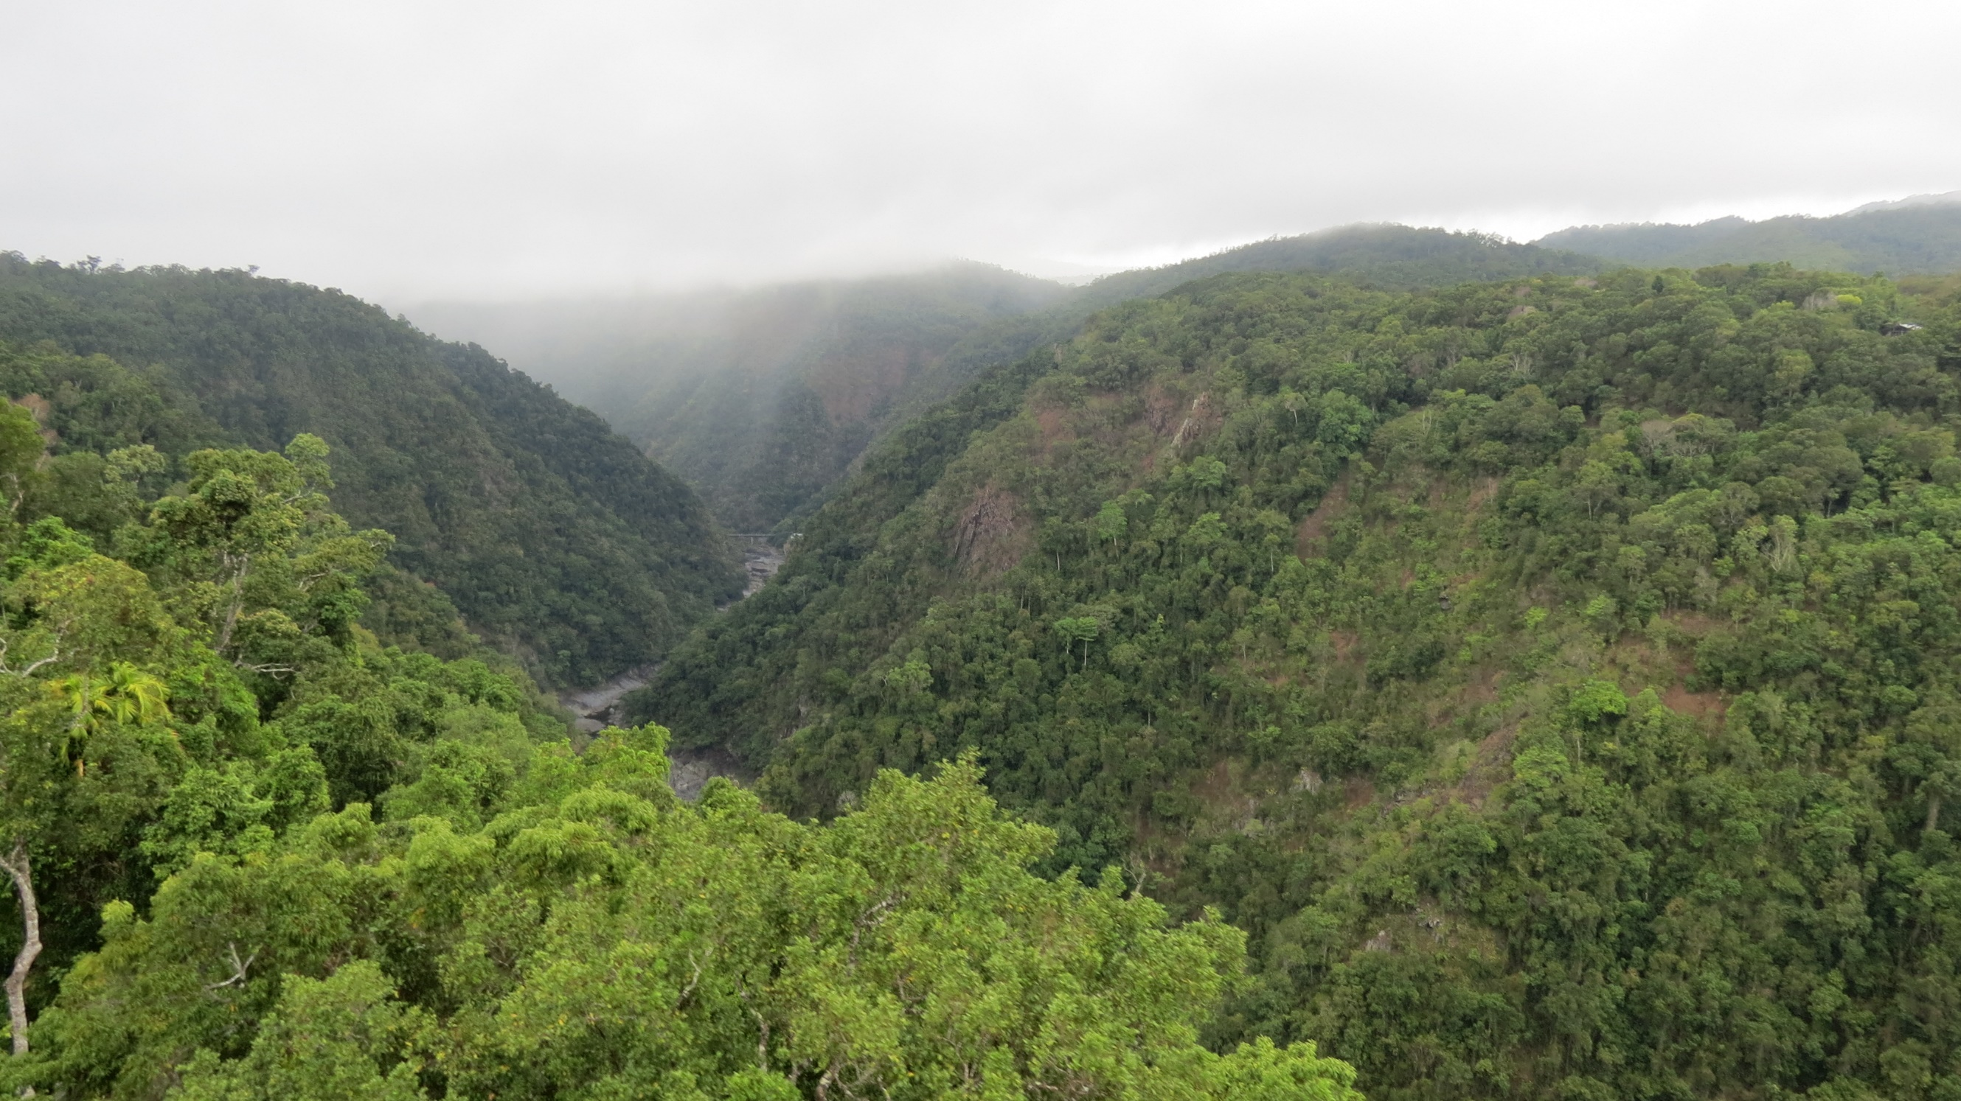

Slide 9
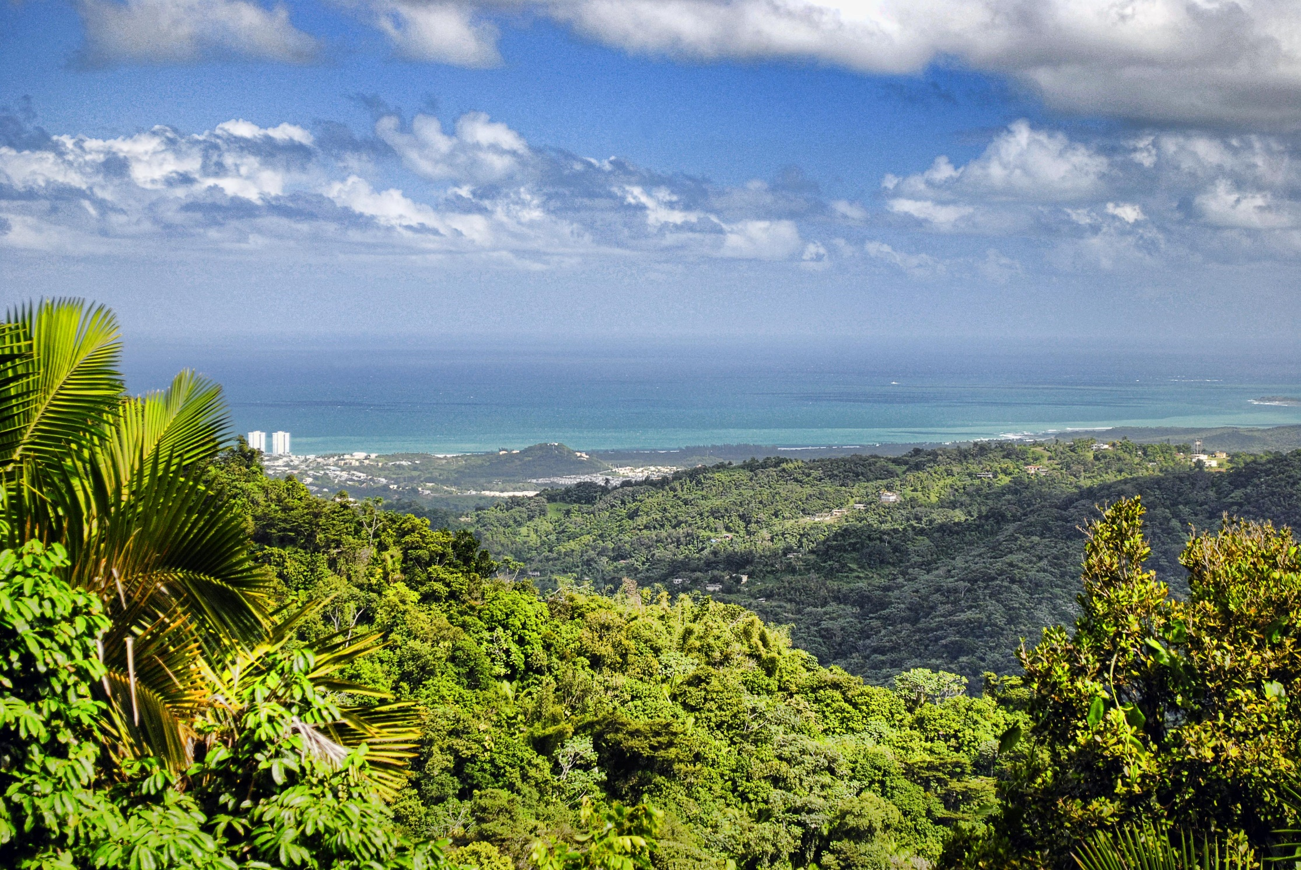

Slide 10
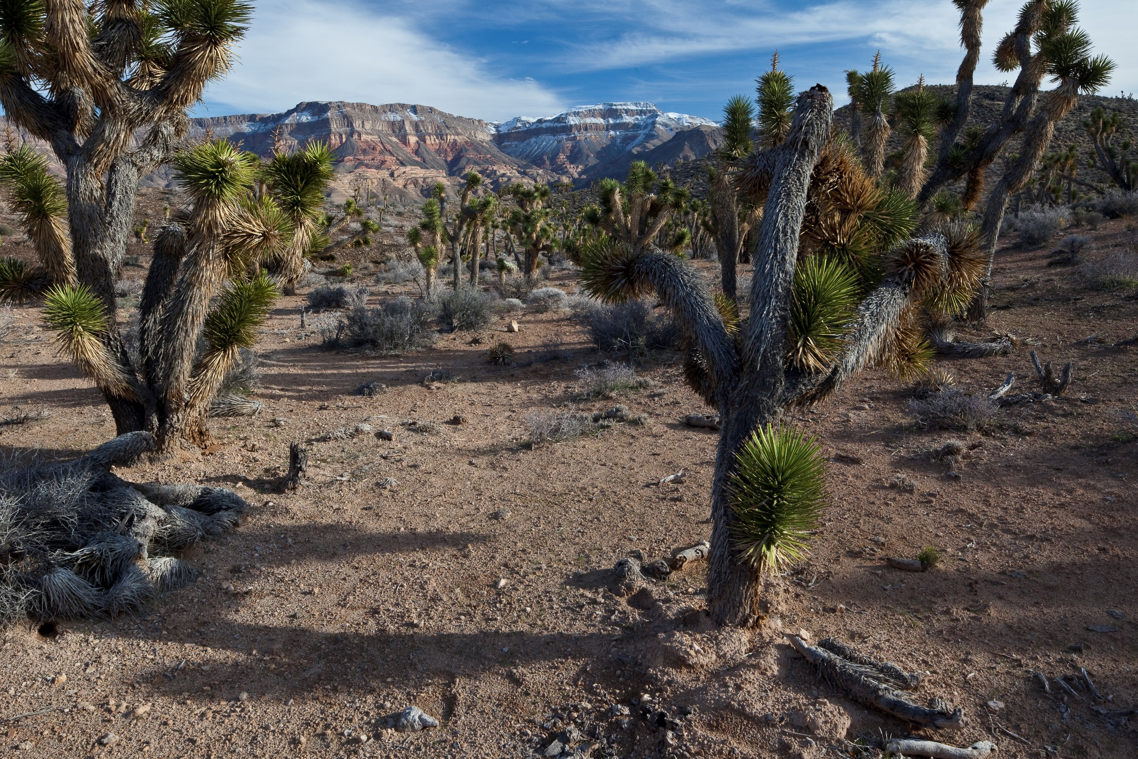

Slide 11
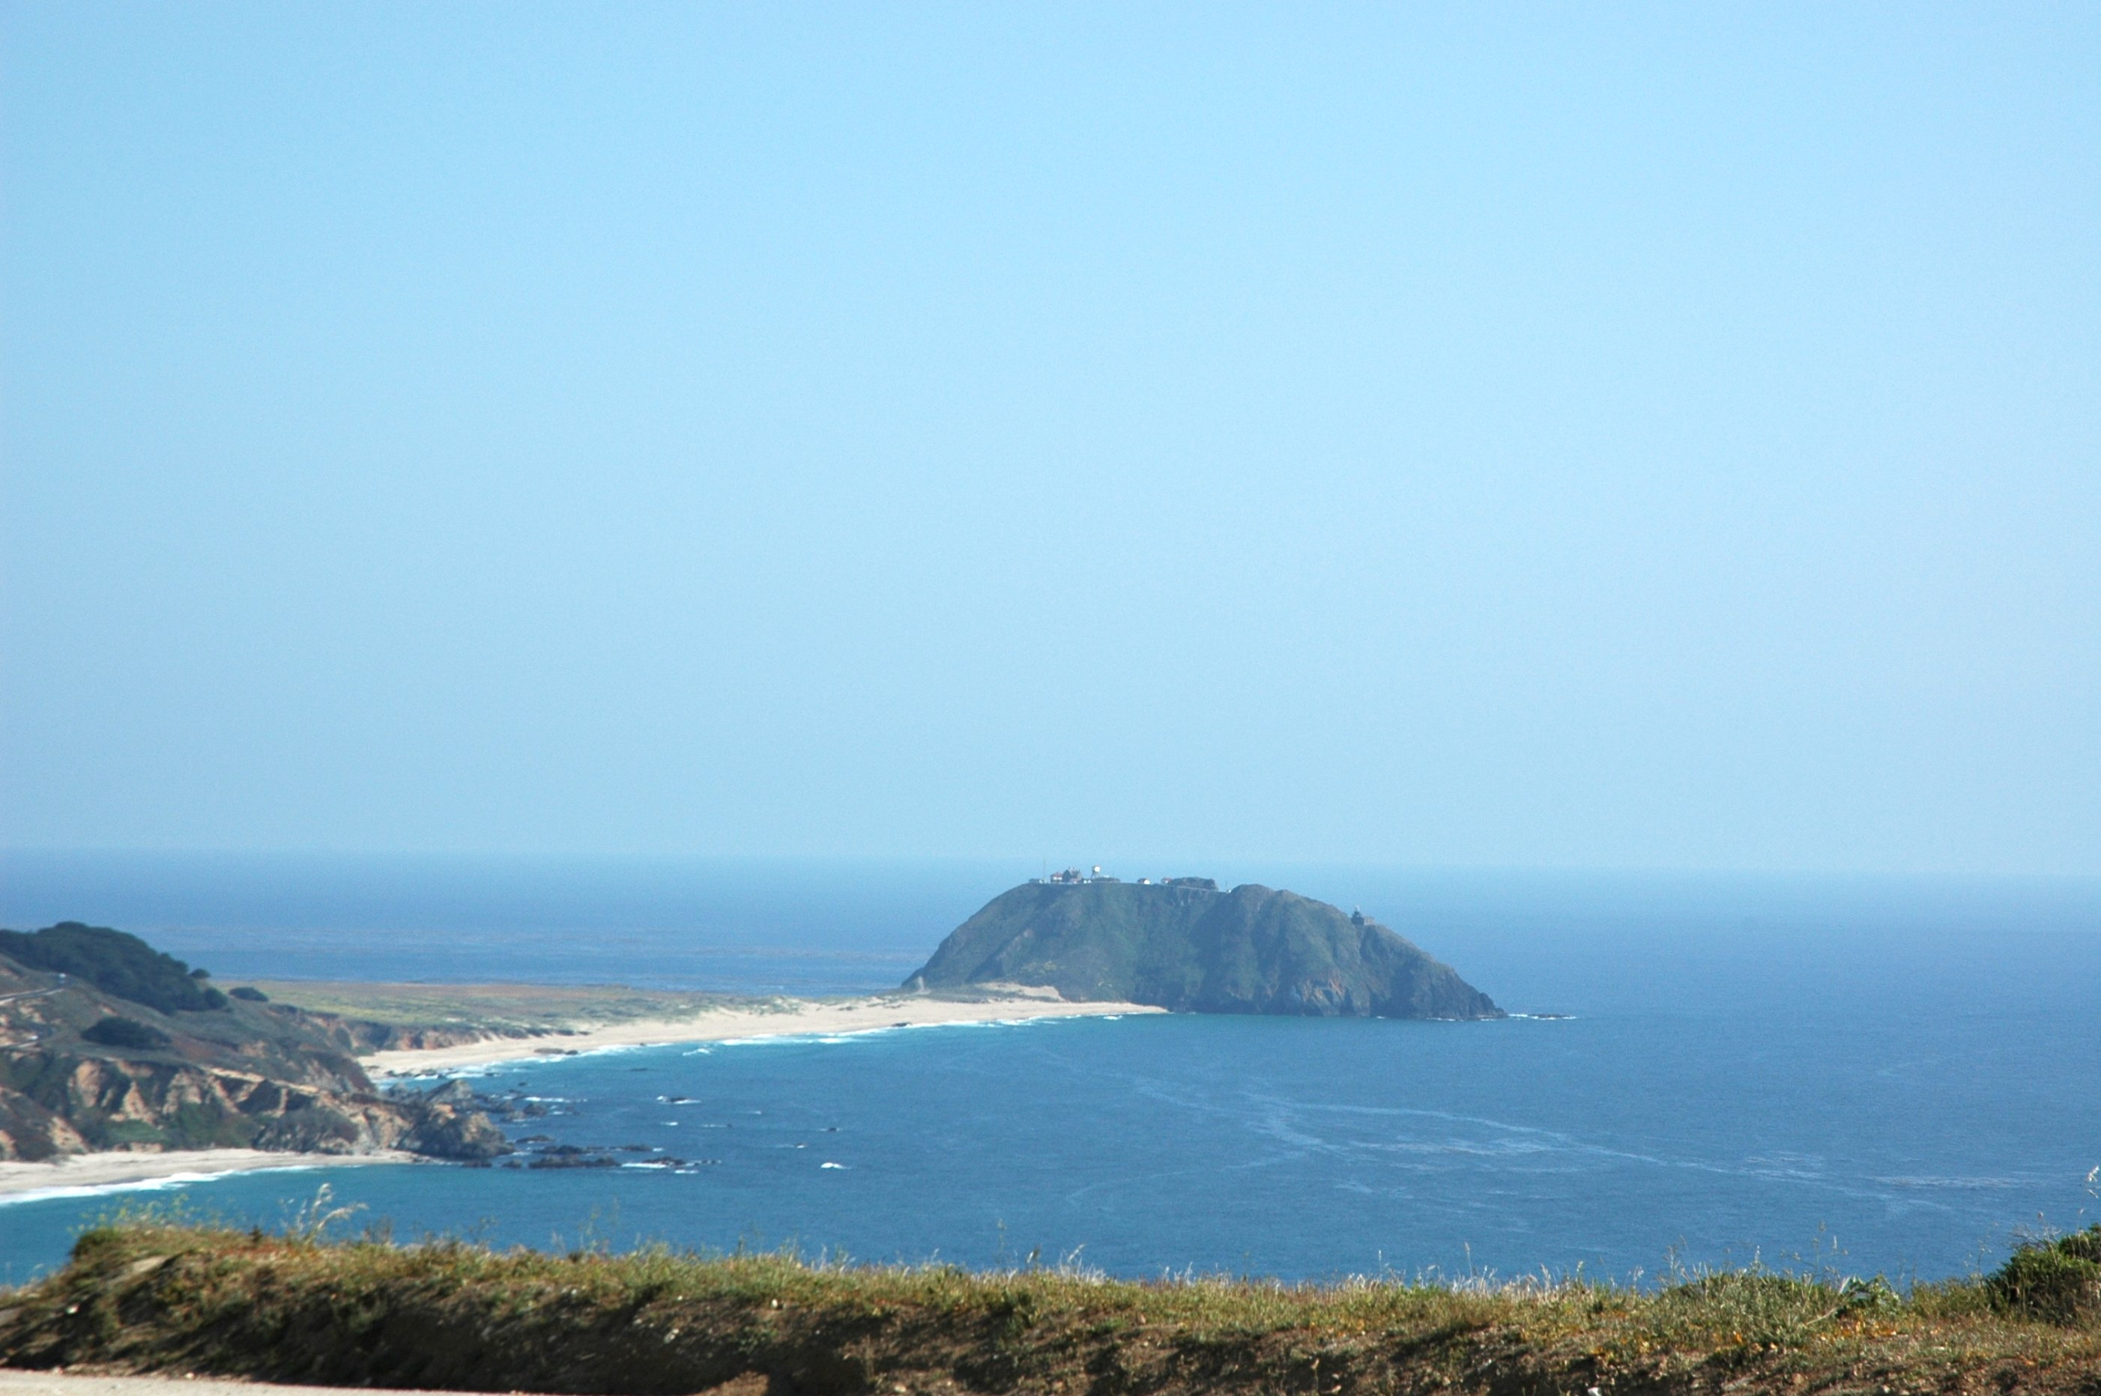

Slide 12
Conclusion
Success Criteria: Able to state examples of a landform and a landscape and explain the difference between the two.
End the less with the video: https://www.youtube.com/watch?v=jadND9e1YyE World’s interesting landforms

